Slide 1

IMPACT OF U.S. TARIFF INCREASES ON THE CANADIAN ECONOMY
ANLT 601
PREPARED BY
Ke Zhang
APRIL 2025
Notes:
Good afternoon everyone,
My name is Ke, and I was one of Daryl’s students last semester in the Technology Management.
Today, I’m excited to share with you my Power BI case study project, titled “Impact of U.S. Tariff Increases on the Canadian Economy.”
During this project, I did some research, collected some data, created some charts using power BI and explored how the tariff on Canadian goods especially steel and aluminum affected Canada’s trade performance, key economic indicators, and industrial sectors.

Slide 2
AGENDA
Problem Definition
Business Problem Overview and Solution Approach
Existing Data Tables Overview
Data Sources & Data Dictionary
Exploratory Data Analysis
Conclusions and Recommendations
Notes:
During today’s presentation, I will walk you through the entire project process —
from how I selected the topic and designed the research framework, to how I collected, cleaned, and visualized data using Power BI.
Specifically, our presentation will cover six main parts: 1. Project Overview – the background, objectives, and scope of our study;
2. Data Planning and Design – how I identified the data I needed;
3. Data Cleaning and Transformation – how I prepared the data for analysis;
4. Dashboard Development in Power BI – how we built and structured the visualizations;
5. Key Insights and Findings – what we discovered from the data;
6. Conclusions and Policy Recommendations – what our analysis suggests for decision-makers.
By the end of this session, I hope you’ll have a clear understanding of how we applied analytical thinking and visualization tools to explore a real-world economic issue.
Let’s begin with the first part — the Project Overview.

Slide 3

PROBLEM DEFINITION
Background
In recent years, the United States has imposed increased tariffs on several key imports from Canada, including steel, aluminum, and automotive components. These measures have raised concerns about the potential economic repercussions for Canada, a country with strong trade ties to the U.S.
Core Problem
There is limited empirical evidence quantifying the actual impact of U.S. tariff increases on the Canadian economy. Key questions remain:
Have these tariffs significantly disrupted Canada’s trade volumes, GDP growth, employment levels, and industrial output?
Which sectors have been most affected?
Are the observed effects short-term disruptions or signs of long-term structural shifts?
Page 1
Notes:
1. Topic & Background（选题背景）
Our project focuses on the impact of U.S. tariff increases on the Canadian economy. In 2018, the United States imposed significant tariffs on Canadian steel and aluminum under Section 232 of the Trade Expansion Act.
These tariffs disrupted long-standing trade relations between the two countries — Canada being one of the U.S.’s largest trading partners.
The Canadian government responded with retaliatory tariffs on American goods.
This situation created an excellent opportunity to explore how such trade policies influence economic performance across sectors, prices, and employment.
2. Research Objectives（研究目标）
The main goal of this project was to analyze how U.S. tariffs affected Canada’s trade, industry performance, and macroeconomic indicators.
Specifically, we aimed to answer four key questions:
1. How did the total trade volume between Canada and the U.S. change after the tariffs?
2. Which sectors — such as metals, manufacturing, or agriculture — were most affected?
3. Did these changes influence broader economic indicators like GDP, employment, and inflation?
4. What patterns or correlations can be observed that may help policymakers prepare for future trade shocks?

Slide 4




BUSINESS PROBLEM OVERVIEW &
SOLUTION APPROACH
Problem Statement:
The U.S. tariff increases have introduced new economic uncertainty for Canada, especially in trade-sensitive sectors. As a major trading partner, Canada faces challenges such as:
Reduced export competitiveness
Potential decline in manufacturing output
Job losses in key industries
Overall economic slowdown
Solution Approach
To address this problem, we follow a structured data analytics methodology:
Data Collection: From Statistics Canada, Bank of Canada, U.S. ITC, and CBSA covering trade flows, tariffs, and economic indicators.
Data Preparation: Cleaning, transforming, and aggregating data (monthly → quarterly) to enable robust comparisons.
Analysis in Power BI:
Trend and correlation analysis between tariff changes and key indicators.
Sector-specific impact assessment.
Visual dashboards to present findings.
Insights & Recommendations:
Short- and long-term economic impacts.
Policy recommendations for government decision-making.
Page 2
Notes:
3. Time Scope（分析时间范围）
We focused on data from 2017 to 2019, which captures the period before and after the tariff implementation,
this allowed us to observe short-term and medium-term impacts of the tariff changes on trade and economic activity.
Also avoiding the distortions caused by the COVID-19 pandemic starting in 2020.
4. Tools & Methodology（工具与方法）
The overall workflow included four stages:
1. Data collection
2. Data cleaning and transformation
3. Data modeling and analysis
4. Dashboard design and visualization
Through this structured approach, we combined economic reasoning with visual storytelling to derive actionable insights.
---> Data Planning and Design

Slide 5

DATA SOURCES
Source | Description
Statistics Canada | Monthly import/export data by commodity and country.
Bank of Canada | National economic indicators (GDP, interest rate, inflation).
U.S. International Trade Commission (USITC) | Tariff rates and changes by product category
Canada Border Services Agency (CBSA) | Canadian tariff classifications and enforcement data
Page 3
Notes:
1. How do I start?
When I first started this project, the biggest question I had was — “Where do I even begin?”
Because when you’re dealing with something as big as the entire Canadian economy, the amount of data out there is… well, terrifying.
So instead of downloading everything I could find — which could crash Power BI —
I decided to start with a simple but powerful question: “What do I actually need to measure?”
And that’s when we introduced one of the most important parts of our project — KPI design
Think of KPIs as the compass of our analysis. Without them, we’d be lost in tons of CSV files.
2. Designing Our KPIs
I designed my KPIs based on the research questions I wanted to answer. For example:
* To understand trade performance, I used indicators like total exports, imports, and trade balance.
* To measure economic health, I selected GDP, employment rate, and manufacturing output.
* And to capture price and cost pressures, I included producer price index (IPPI), consumer price index (CPI), and exchange rate (CAD/USD).
Each of these KPIs connects directly to one of our research goals, making sure that every number we collect has a clear purpose.
3. Identifying Data Sources
Once we knew what we needed, the next step was to find where to get it. And of course, we wanted reliable and official data — not someone’s spreadsheet from Reddit.
So our main sources were:
* Statistics Canada, for trade, GDP, CPI, and employment data;
* Bank of Canada, for manufacturing output and exchange rate;
* U.S. International Trade Commission (USITC) and Canada Border Services Agency (CBSA) for tariff rates and policy timelines.
In short, every dataset came from a trusted government source — which also meant every dataset came with… a unique format and lots of cleaning to do later!

Slide 6
Table | Description
GDP (All Industry) / (Primary Metal Manufacturing) | National GDP across all industries and Sector-specific GDP data (NAICS 331) (monthly)
Labour Force (All Industry) / (Manufacturing) | Employment levels across all sectors and manufacturing industries.
Consumer Price Index (Durable) | Price index for consumer durable goods.
Industrial Product Price Index (Metal) | Producer prices in the metal manufacturing sector
Exchange Rate | Monthly average CAD/USD exchange rat
EXISTING DATA TABLES
2. ECONOMIC INDICATORS
Table | Description
Total Trade Volume | Monthly import & export values from all countries to Canada
Top 5 Countries Trade Volume | Trade comparison by top trading partners (U.S., China, etc.)
Metal Import & Export (Canada - U.S.) / (Canada - China) | Monthly steel & aluminum trade volume with the U.S. and China
Consumer Goods Import & Export (Canada - U.S.) / (Canada - China) | Monthly consumer goods trade values from the U.S. and China
Iron and Steel Export and Import (Canada Total) | National-level iron and steel trade trends
1. TRADE VOLUME DATA
Table | Description
U.S. Tariffs on Canadian Iron & Steel | Import value, tariff rate (%) and calculated duties for U.S. tariffs on Canadian steel products
3. TARIFF DATA
Page 4
Notes:
Data Categories & Structure（数据类别与结构）
Altogether, we built our analysis around 3 main data categories:
1. Trade Data – exports, imports, and trade balance by product type;
2. Economic Indicators – GDP, employment, manufacturing output; 3. Sector Data – focusing on key industries like steel, aluminum, and automotive; 4. Tariff Information – including implementation dates and tariff rates.
2. ETL
Now that we’ve identified what data we needed and where to find it,
it’s time to deal with every analyst’s favorite part — data cleaning.

Slide 7
DATA DICTIONARY
Variable | Description
Trade | Type of trades(Import, Export, Trade Balance)
Principal trading partners | Countries traded with Canada(U.S., China)
VALUE(Million dollars) | Total amount of trade value(Canadian dollars)
North American Product Classification System (NAPCS) | Type of trading goods(Metal and non-metallic mineral products [C14], Consumer goods [C22])
North American Industry Classification System (NAICS) | Type of industries(Total,all industries, Manufacturing [31-33], Primary metal manufacturing [331])
Page 5
Notes:
3. Data Preparation & Cleaning
And let’s be honest: this is the part that separates data analysts from data adventurers. Because at this stage, you realize that every dataset speaks its own language… some use commas, some use semicolons, and some just … chaos.
So instead of showing you 30 minutes of Power Query steps, I’ll focus on the key questions every student has when preparing data for Power BI.
❓Question 1 – Do we need DAX for measures and calculated columns?
Yes — but only when necessary.
In my case, I created a few simple measures in DAX to calculate trade balance and growth rates, for example:
Trade Balance=[TotalExports]−[TotalImports]
But not every calculation needs DAX — sometimes it’s better to create calculated columns directly in Power Query, especially for static transformations like “Year” or “Quarter.”
The rule of thumb is: If the value changes dynamically with filters → use DAX (measure).
If it’s fixed once loaded → use Power Query (column).
❓Question 2 – When should we use Pivot or Unpivot?
Great question — and the short answer is: whenever your columns look like values instead of variables.
For example, if your table has columns like “2017,” “2018,” and “2019,” Power BI can’t treat those as a time series — they’re just column names.
So we use Unpivot to convert them into two columns: “Year” and “Value.” That makes the data much easier to visualize and aggregate.
On the other hand, Pivot is useful when we want to summarize or group data for quick overviews —
like converting long transaction data into total exports per year.
In short:
* Unpivot → when you want to go long (make columns into rows)
* Pivot → when you want to go wide (make rows into columns)
❓Question 3 – How do we handle dates and missing data?
Dates are the backbone of time-series analysis — and they love to misbehave.
We standardized all date columns to a single format: YYYY-MM-DD, then it’s better to created a unified Date Table in Power BI, which helps manage time hierarchies like Year, Quarter, and Month.
As for missing data — we avoided deleting entire rows.
Instead, we used interpolation or left the cells blank, depending on how critical that value was. Remember: cleaning data shouldn’t mean “erasing history.”
❓Question 4 – How should we manage relationships between tables?
Power BI works best when your data model is relational, not chaotic.
It’s better to us a simple star schema — one central Table connecting to different fact tables like Trade, GDP, and Employment.
This made filtering and cross-analysis smooth —
for example, we could easily see how GDP and trade volume changed during the same month.
🧠 Question 5 – Do we need to normalize or aggregate data before loading?
Yes, and I highly recommend you to follow the normalization rules before load it.
You don’t have to clean data using power query, if your resource allow you to choose different format and even aggregation functions before you download, why not!
So these were some of the main considerations in our data preparation stage. I didn’t cover every step of cleaning — I’m sure Daryl has already taught you everything you need to know about that part. 😉
-→ Dashboard Development in Power BI

Slide 8
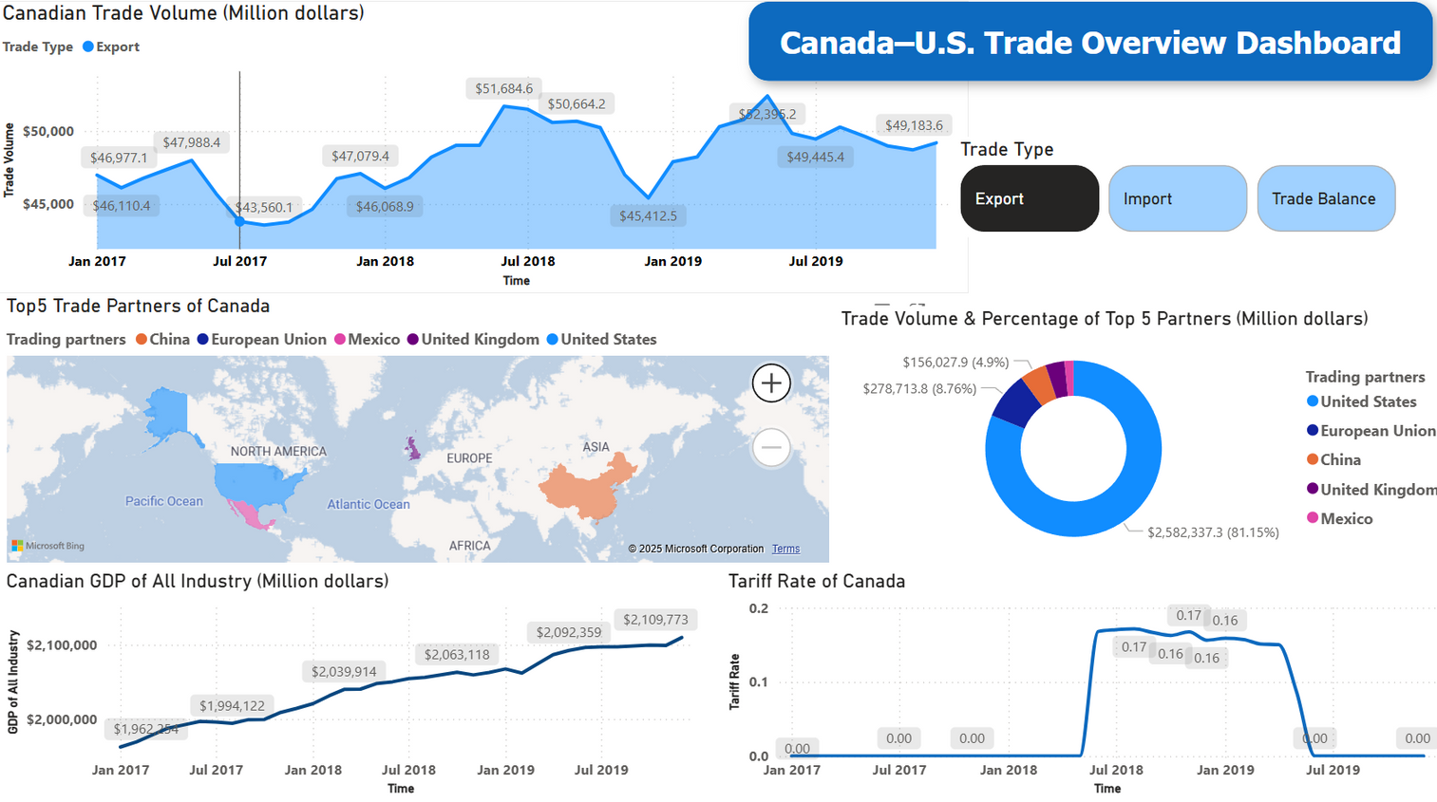
CANADIAN IMPORTS, GDP AND TARIFF TRENDS (2017–2019)
Key Findings from Dashboard Analysis
Decline in Overall Trade Volume：
Canada’s total trade volume began to decline in Q3 2018, aligning with the timing of U.S. tariff implementation.
This suggests a lagged reaction to increased import costs due to tariffs.
Heavy Dependence on the U.S. ：
The U.S. accounted for over 81% of trade volume among Canada’s top 5 partners.
This high dependence further amplifies the impact of any U.S. trade policy changes.
Slower GDP Growth ：
GDP continued to increase modestly, but the growth rate slowed after 2018.
Despite the external shock, Canada’s overall economy remained resilient, though possibly at a lower trajectory.
Tariff Rate Surge in Mid-2018：
The tariff rate sharply increased in June 2018, peaking at 17.1%, and remained high until early 2019.
The tariffs were completely removed by mid-2019.
Summary Statement：
The dashboard reveals a clear temporal alignment between the imposition of U.S. tariffs and a softening of Canada’s import volume and GDP growth rate. The temporary rise in tariff rates directly correlates with a slowdown in trade expansion, confirming the disruptive influence of external trade policies. Although Canada’s economy remained stable, the data suggests it did so under increased pressure.
Page 6
Page 2
Notes:
What Makes a “Good Dashboard”?
Before showing my dashboard, let’s first talk about what makes a good dashboard.
Because as students, we often spend hours designing charts that look beautiful — but sometimes forget what they’re actually supposed to communicate.
So here’s my opinions: A good dashboard doesn’t just show data — it tells a story.
It should answer three questions:
1. What’s happening? – which means current situation or trend
2. Why is it happening? – key factors or correlations
3. So what? – implications or next steps
In other words, a great dashboard combines clarity, context, and curiosity —
clarity for quick understanding, context to explain meaning, and curiosity to make people want to explore further.
2. What Should a Dashboard Include?
So, what should a complete dashboard include?
Typically, there are three levels of information:
1. Level 1: Overview – The Big Picture
This section gives a quick snapshot of key metrics — total trade, GDP trend, Tariff change, etc. It’s for someone like a government official who only has 30 seconds to understand what’s going on.
2. Level 2: Details – Drill Down by Category
Here we break down data by sector, region, or time period — for example, trade by Country and Time or Economic indicators like GDP and Tariff by month.
3. Level 3: Insights – Correlation
This part shows how tariffs relate to other indicators, like GDP, trade volume.
Together, these levels turn static charts into a narrative flow: from overview → analysis → insight.
3. Introducing Our Project Dashboard
This is the overview page of my Power BI dashboard — the main entry point of our analysis. It brings together the big picture of how Canada’s trade and economy changed after the U.S. tariff increases.
Let’s quickly walk through the key sections of this page.
At the top, we placed three main KPIs — Total Exports, Total Imports, and Trade Balance.
The line chart shows the overall trade trend from 2017 to 2019, with a clear mark for mid-2018, when the tariffs were introduced.
You can instantly notice how trade volume changed right after that period — especially in mid-2018.
This chart tells the story of when things changed.
It’s like the speedometer of the dashboard — before diving into any chart, you already know how the economy is moving.
The map shows you who are the main business partner of Canada and the donuts chart tells you how much of Canada’s total trade was with the U.S. compared to other countries.
At the bottom, we added supporting charts showing key economic indicators — GDP growth and tariff change.
These charts help connect trade patterns to broader economic conditions:
for example, even when trade drop down, GDP stayed relatively stable, suggesting that the impact was sector-specific rather than a full-scale downturn.
In short, this part provides the economic background for the whole story.
4. Design Choices
We kept the design clean and consistent:
Simple fonts, consistent units and data aggregation
Slicers on the right allow users to explore by Export, import or Trade Balance.
The goal was to make the dashboard executive-friendly:
informative enough for analysts, but clear enough for policymakers.
5. Wrap-up
So this overview page serves as the “landing page” of our project —
it summarizes the entire economic picture in one glance, from trade to GDP, from partners to performance.
The following pages in our dashboard dive deeper into specific areas like prices, employment, and industries.
But everything begins right here — with this page that tells the whole story in a single frame.

Slide 9
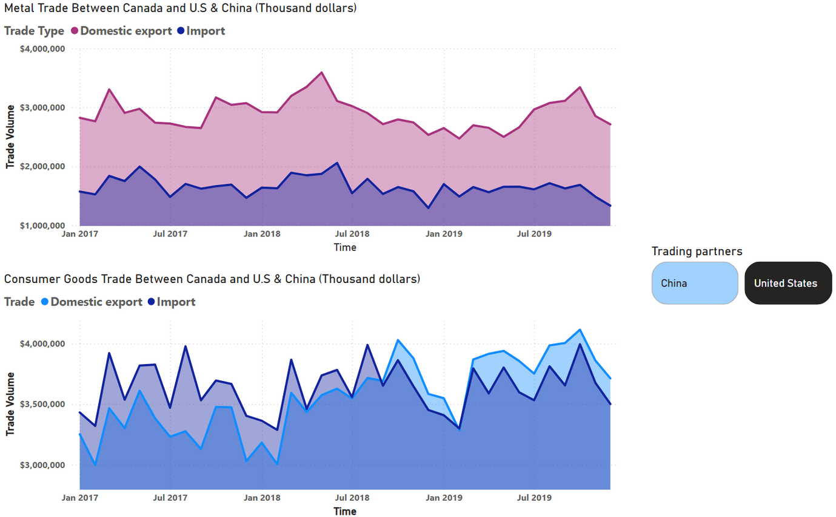
VARIATE ANALYSIS：
TRADE WITH U.S.
Key Observations from Trade Analysis
Metal Trade Between Canada and the U.S.：
Import volumes of metal products from the U.S. remained relatively stable before mid-2018.
After mid-2018, a sharp decline is observed in metal imports, coinciding with the introduction of U.S. steel and aluminum tariffs in June 2018.
This pattern suggests a direct impact of tariffs on Canada’s metal import behavior.
Consumer Goods Trade Between Canada and the U.S. ：
Import volumes of consumer goods from the U.S. showed no significant long-term decline post-2018.
Despite minor fluctuations, the import levels continued to grow steadily through 2019.
This implies that consumer goods trade was less sensitive to tariff policies compared to industrial goods like metal.
Summary Statement：
While metal imports experienced a notable downturn following the introduction of U.S. tariffs in 2018, the trade of consumer goods remained relatively unaffected. This indicates that the tariffs had a targeted impact, primarily disrupting industrial supply chains rather than general consumer imports.
Page 7
Page 2
Notes:
What is Univariate Analysis?（什么是单变量分析？）
Before diving into the visuals, let’s first understand what univariate analysis means.
In simple terms, “univariate” means one variable at a time — we analyze how a single indicator behaves across time, without yet combining it with others.
The goal here is to build a baseline understanding: what each variable — such as trade volume, price index, or employment rate — looks like individually.
Once we clearly understand each one on its own, we can move on to multivariate analysis, where we explore how these variables interact — for example, how tariffs might affect both trade and employment together.
2. Why Separate Univariate and Multivariate Analysis?
If we jump straight into correlations, we might miss the individual stories. For instance, if both trade and unemployment change after 2018, we can’t tell whether that’s coincidence or not — until we understand how each behaved on its own.
So, this section — the univariate part — focuses on individual trends, and the next part will connect those dots into cause-and-effect relationships.
📊 Now let’s walk through our four Univariate dashboards
1.1 Trade with the U.S. & China
First, let’s look at trade between Canada and the U.S. — the country most directly affected by the tariff dispute.
The first chart shows metal trade. Imports from the U.S. were stable until mid-2018, then dropped sharply right after the U.S. imposed steel and aluminum tariffs in June 2018. This clearly shows a direct tariff impact — industrial imports reacted immediately.
Below that, we have consumer goods trade, which, interestingly, stayed quite stable — even slightly growing through 2019.
This suggests that the tariffs mainly targeted industrial supply chains, while everyday consumer products were much less affected.

Slide 10
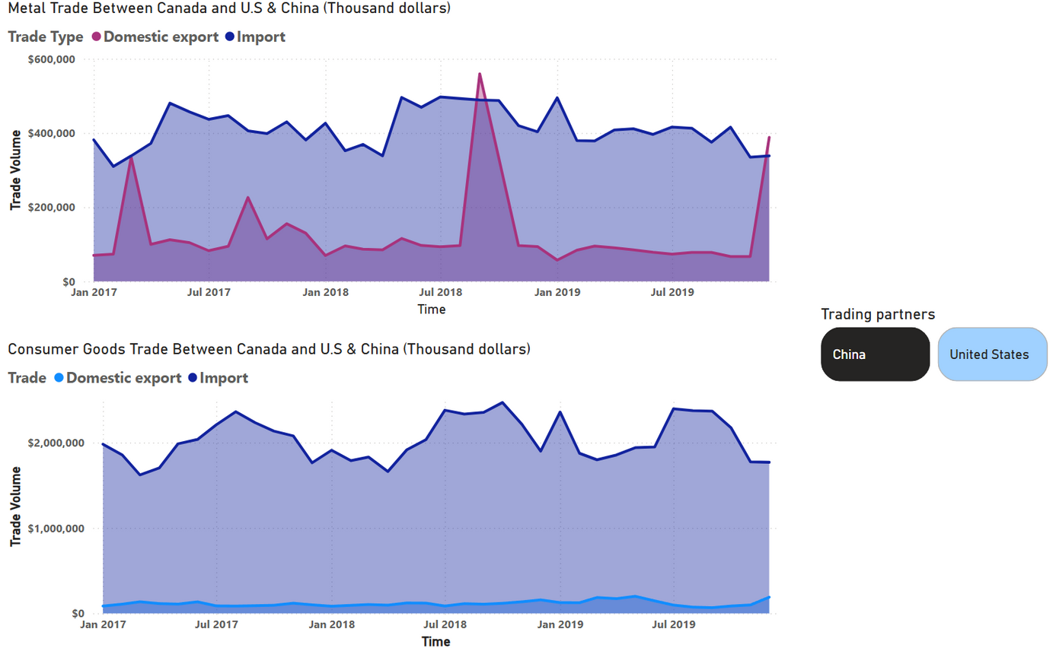
VARIATE ANALYSIS：
TRADE WITH CHINA
Key Observations from Trade Analysis
Metal Trade Between Canada and China：
Metal imports from China remained relatively stable over the entire period, fluctuating mildly between $350M–$450M per month.
No obvious decline post-2018; instead, a slight rebound in late 2019 is observed.
This contrasts with the sharp drop seen in Canada-U.S. metal trade post-tariff, suggesting China was unaffected by U.S.-Canada tariff disputes.
Export data (from Canada to China) remained low and volatile, with one-off spikes (e.g., mid-2018), likely due to isolated deals.
Consumer Goods Trade Between Canada and China ：
Imports of consumer goods from China stayed consistently high, fluctuating in a narrow range ($5M–$7M).
No sign of disruption during 2018–2019, showing that this trade flow was resilient and stable.
Exports from Canada to China remained negligible, indicating a strong one-way trade dependency in this category.
Summary Statement：
Unlike the Canada–U.S. metal trade, Canada’s trade with China—both in metals and consumer goods—remained stable throughout the 2017–2019 period. This highlights that the decline in metal trade volume was a targeted bilateral issue with the U.S., not a global trend. China did not introduce retaliatory trade restrictions on Canadian metal or consumer goods during this time.
Page 8
Page 2
Notes:
1.2 Trade with China
Now, let’s compare that with trade between Canada and China.
Here, we see a completely different story. Metal trade volumes with China remained relatively stable from 2017 to 2019, showing no clear decline after mid-2018 — unlike the sharp drop we saw with the U.S.
The same pattern appears in consumer goods trade — imports from China stayed high and steady, meaning China’s trade was unaffected by the U.S.-Canada tariff conflict.
This comparison tells us something crucial: The trade shock was specific, not global — it was specific to the U.S.-Canada relationship.

Slide 11
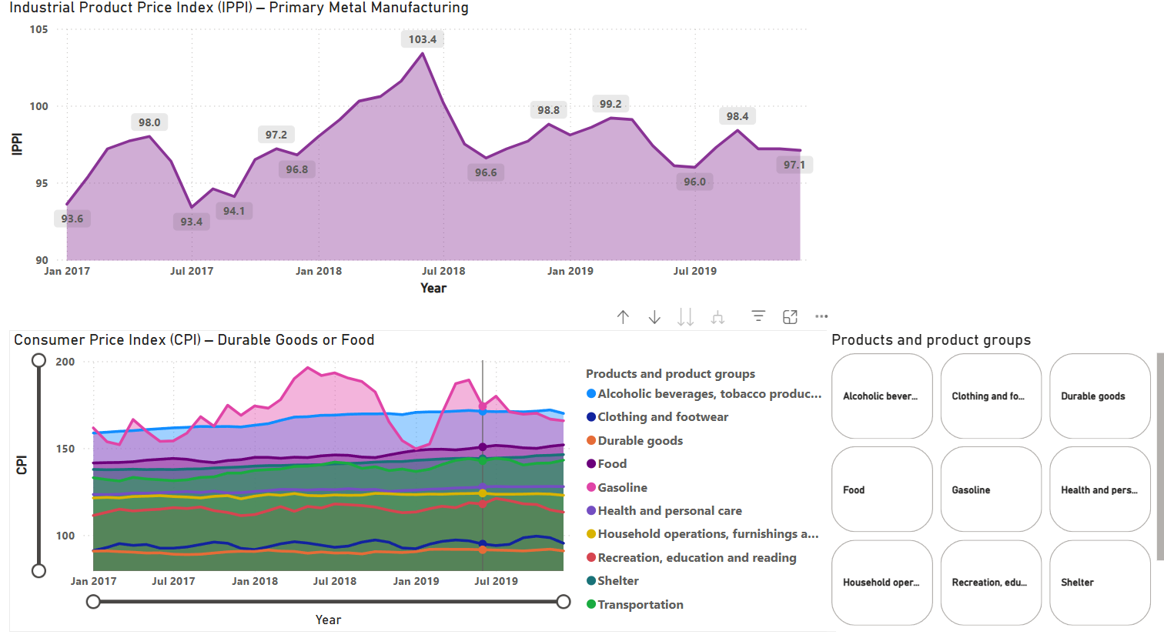
PRICE-BASED INDICATORS UNDER TARIFF IMPACT
Key Observations from Trade Analysis
Industrial Product Price Index (IPPI)：
The IPPI steadily rose from early 2017 and reached a peak of 103.4 in July 2018, immediately following the implementation of U.S. tariffs on Canadian steel and aluminum.
Surprisingly, the IPPI declined significantly after mid-2018, falling back to around 96–99 by late 2019.
Possible reasons for the decline:
Manufacturers absorbed costs rather than passing them on, in order to maintain competitiveness under increased trade barriers.
Industrial demand weakened, especially in export-heavy sectors, leading to lower pricing pressure.
Global metal and commodity prices dropped in late 2018 amid broader trade tensions (e.g., U.S.–China trade war), indirectly lowering production input costs.
Exchange rate fluctuations may have affected import costs and factory gate prices.
Consumer Price Index (CPI)：
Consumer price trends remained flat or slightly declining across categories such as durable goods and food in 2019.
Contrary to expectations, no inflationary spike occurred during the tariff period.
Possible reasons for this CPI behavior:
Limited cost pass-through from producers to consumers.
Consumer spending weakened, restricting retailers’ pricing power.
Some imported goods may have been substituted by domestic or alternative sources, dampening pricing pressure.
Summary Statement：
While tariffs typically increase production costs, both IPPI and CPI dropped after mid-2018. This counterintuitive outcome suggests that Canada’s producers and retailers chose to stabilize prices amid declining demand and global economic uncertainty. The result was a deflationary trend instead of expected inflation, highlighting how external shocks like tariffs can suppress rather than accelerate price growth when market confidence is low.
Page 9
Page 2
Notes:
2. Price-Based Indicators (IPPI & CPI)
Next, let’s look at price indicators — specifically, the Industrial Product Price Index (IPPI) and the Consumer Price Index (CPI).
The IPPI — mainly for metals and manufacturing — rose steadily before mid-2018, peaking right after the tariffs were introduced, and then fell sharply afterwards.
That’s a bit counterintuitive — tariffs usually push prices up, but here, producers likely absorbed costs to stay competitive, or global demand weakened.
The CPI, covering consumer categories like food, gasoline, and durable goods, stayed mostly flat — no sign of inflation despite the tariffs.
In short: tariffs didn’t trigger higher prices — instead, they created a deflationary environment in late 2018–2019.

Slide 12
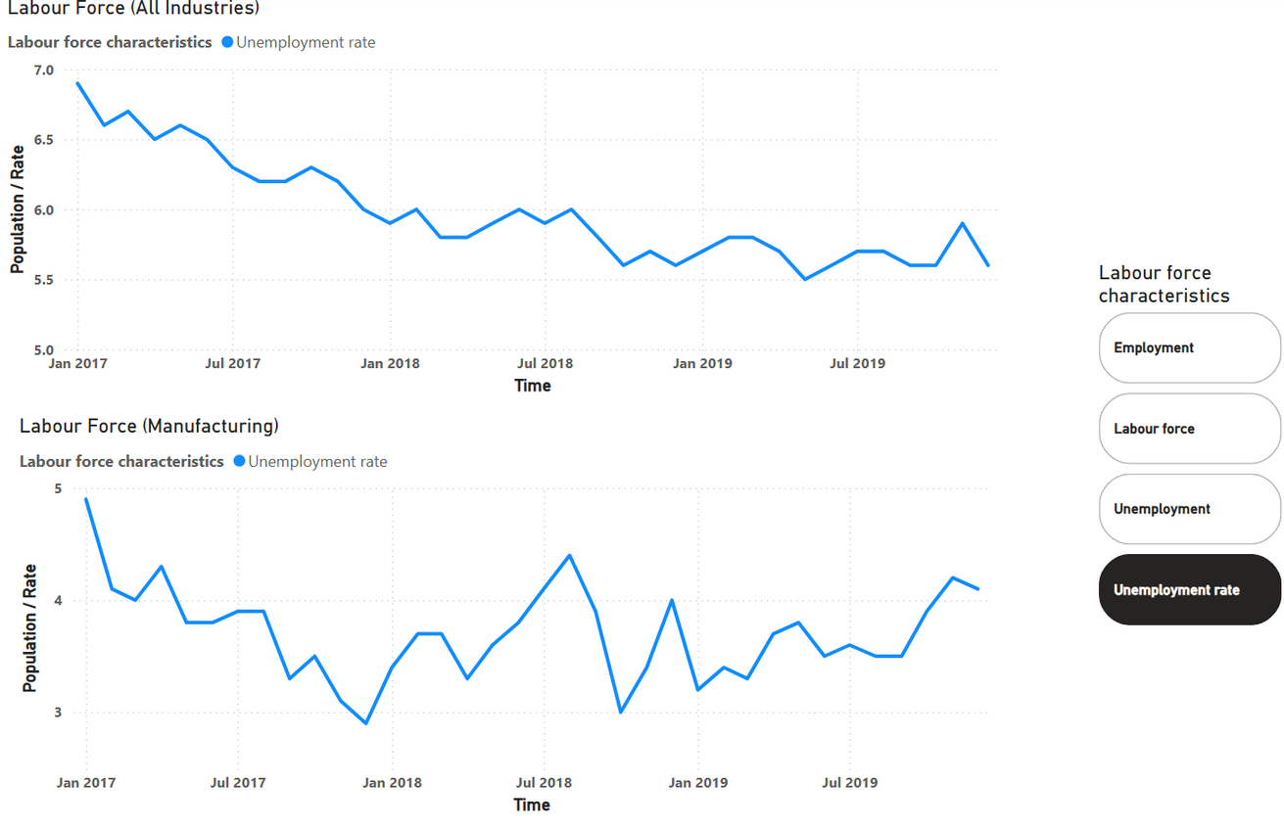
LABOUR FORCE RESPONSE TO TARIFF IMPACT
Key Observations from Trade Analysis
Unemployment Rate – All Industries：
The national unemployment rate steadily declined from 6.9% in early 2017 to around 5.5% in late 2018.
However, after mid-2018, coinciding with the U.S. steel & aluminum tariffs, there was a small but noticeable increase in the unemployment rate, peaking near 5.9% in late 2019.
Employment in Manufacturing:
Manufacturing employment increased through 2017, peaking in early 2018 at ~1.82 million.
After the tariff implementation in mid-2018, employment began a downward trend, falling to ~1.71 million by the end of 2019.
The drop was gradual at first, then sharp in mid-2019, indicating a lagged response to trade policy pressures.
Possible Explanations：
Tariff-related cost increases may have reduced competitiveness and order volumes for Canadian manufacturers, especially in metal-heavy industries.
Export-reliant firms likely responded by slowing hiring or downsizing, especially when U.S. demand weakened.
The overall job market remained resilient, suggesting the impact was sector-specific, with manufacturing bearing the brunt.
The slight increase in unemployment reflects this concentrated effect—not a macroeconomic crisis, but a targeted industrial adjustment.
Summary Statement：
While Canada's national unemployment rate showed only mild fluctuations after the 2018 tariff implementation, the manufacturing sector experienced a more tangible employment decline. This suggests that the labour market impact of U.S. tariffs was not widespread but significantly felt in industrial sectors directly tied to cross-border trade.
Page 10
Page 2
Notes:
3. Labour Force Response
Finally, let’s examine the labour market response.
The top chart shows the overall unemployment rate — steadily declining through 2017–2018,
but showing a slight uptick after mid-2018, coinciding with the tariff period.
The bottom chart focuses on manufacturing employment, and here, the effect is stronger — employment peaked in early 2018 and fell afterward.
This indicates that tariff pressure hit manufacturing jobs directly, while the broader labour market stayed relatively stable.
4. Wrap-up Transition
So to summarize, our univariate analysis shows:
* Metal trade and manufacturing were the most sensitive to tariffs;
* Consumer trade and prices remained stable;
* And the employment impact was localized, not nationwide.

Slide 13
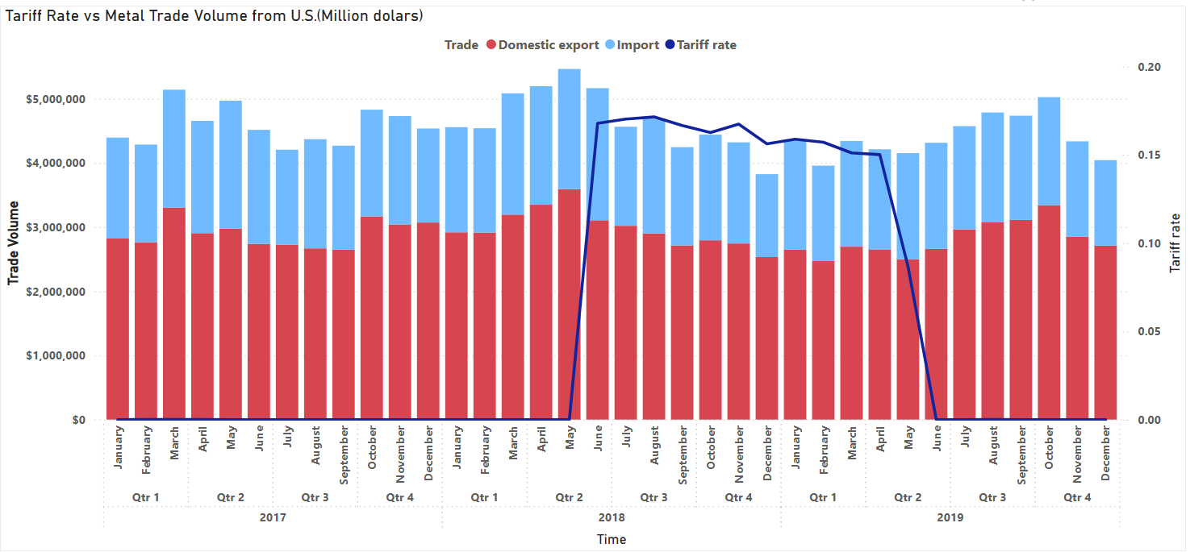
Key Observations from Trade Analysis
Tariff Implementation (June 2018):
A significant rise in the U.S. tariff rate began in June 2018, reaching nearly 17%, and lasted for approximately one year until mid-2019.
Impact on Trade Volume:
After the tariff was imposed, both metal imports and exports declined sharply, particularly:
Imports dropped from ~$1.8M to below $1.5M in several months.
Exports also fell, although with relatively less fluctuation than imports.
Post-Tariff Adjustment (Mid-2019):：
Once the tariff rate returned to 0%, there was a slight rebound in trade, but it did not recover to pre-tariff levels, especially for imports
Analysis of the Decline:
Tariff Effect:
Higher tariffs increase the cost of imported Canadian metals for U.S. buyers, leading to reduced demand and lower transaction volumes.
Supply Chain Disruption:
Canadian exporters may have redirected their metal exports to other countries, or faced reduced production, anticipating long-term policy uncertainty.
Investment and Production Lag:
Domestic producers may have cut back investment or slowed production due to the unfavorable export conditions, causing ongoing lower output even after tariffs were lifted.
TARIFF RATE VS METAL TRADE VOLUME
This chart displays the monthly trade volume of metal products between Canada and the United States from January 2017 to December 2019, alongside the U.S. tariff rate on Canadian steel and aluminum products.
Summary Statement：
The sharp decline in Canada-U.S. metal trade volume after the implementation of U.S. tariffs demonstrates a clear inverse relationship between tariff rates and trade activity. Although trade began to recover once tariffs were lifted, the full restoration of pre-tariff trade levels was not achieved within the observed timeframe, suggesting lasting economic impact from protectionist trade measures.
Page 11
Page 1
Notes:
1. What is Multivariate Analysis?（什么是多变量分析？）
Now we move to multivariate analysis — where we connect those variables to see how they interact.
In short, univariate analysis tells us “what changed,” while multivariate analysis helps us understand “why it changed.”
Here we overlay multiple indicators — tariff rates, trade volumes, GDP, employment, and prices — to discover the relationships among them.
Think of this section as putting puzzle pieces together to see the full economic picture.
Let’s go through each dashboard page
Tariff Rate vs Metal Trade Volume
This chart combines U.S. tariff rate and metal trade volume between Canada and the U.S. .
When tariffs were introduced in June 2018, reaching nearly 17%, metal imports dropped sharply within a few months.
Exports also declined but less dramatically.
After tariffs were removed in mid-2019, trade rebounded slightly — but never returned to pre-tariff levels.
This shows a clear inverse relationship between tariff rates and trade activity.

Slide 14
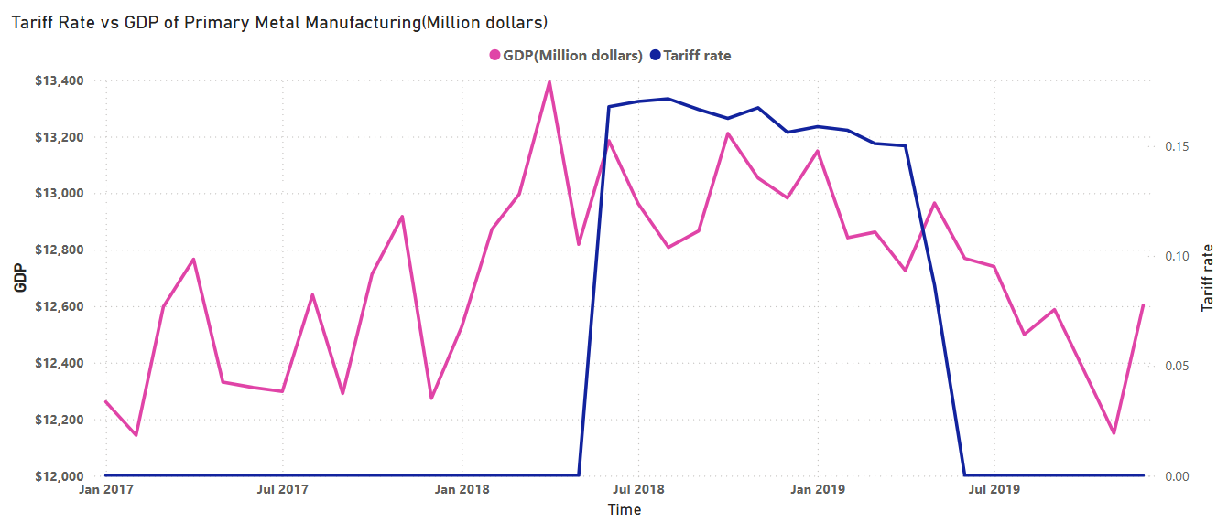
TARIFF RATE AND GDP OF PRIMARY METAL MANUFACTURING
Key Observations from Trade Analysis
Tariff Period (June 2018 – May 2019):
The U.S. imposed a tariff of up to 17% on Canadian steel and aluminum starting from mid-2018 and maintained it for roughly a year.
GDP Trend Post-Tariff:
The GDP dropped sharply from a peak of ~$13.4 billion in early 2018 to a lower average level.
The GDP remained volatile, with fluctuations but an overall downward trend throughout the tariff period.
Even after the tariffs were removed in mid-2019, GDP did not return to pre-tariff levels.
Reasoning Behind the Decline:
Reduced Export Demand:
The U.S. is the largest market for Canadian metal exports. Tariffs reduced competitiveness, leading to fewer orders and lower production in Canada.
Investment Hesitation:
Uncertainty around trade policies likely caused delays in investment, expansion, and capital expenditures in the sector.
Cost & Supply Chain Disruption:
Input costs may have increased or supply chains became less efficient, leading to margin compression and lower GDP contribution.
This chart visualizes the relationship between U.S. tariff rates and the GDP of Canada’s Primary Metal Manufacturing sector from January 2017 to December 2019.
Summary Statement：
The implementation of U.S. tariffs on Canadian metals had a direct negative impact on the GDP of the Primary Metal Manufacturing sector. The data clearly indicates that trade restrictions can suppress industrial economic output, and the effects may persist even after tariffs are lifted due to lasting business uncertainty and structural shifts in supply chains.
Page 12
Page 1
Notes:
2. Tariff Rate and GDP of Primary Metal Manufacturing
This page connects tariff rates with the GDP but not national wide, but Canada’s primary metal manufacturing sector.
We can see GDP peaking around $13.4 billion before the tariffs, then declining throughout 2018 and 2019.
Even after tariffs were lifted, GDP did not fully recover.
The explanation is straightforward: tariffs reduced export demand, increased production costs, and created uncertainty — all of which suppressed industrial output.

Slide 15
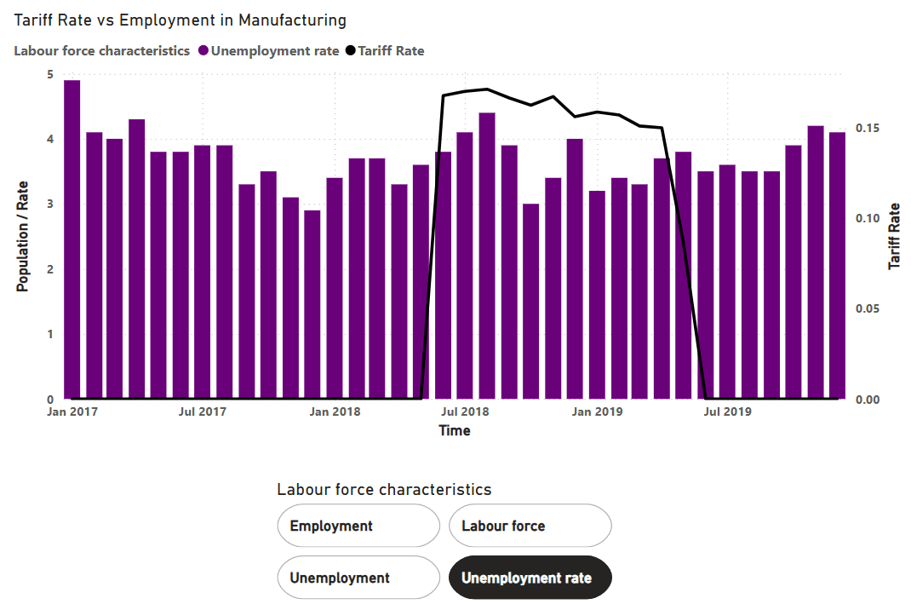
TARIFF RATE AND EMPLOYMENT OF MANUFACTURING
Key Observations from Trade Analysis
Tariff Period (June 2018 – May 2019):
U.S. tariffs on Canadian metal products were imposed from June 2018 to May 2019, marked by the black line (right axis).
Unemployment Trend During Tariff Period:
Prior to tariffs, the unemployment rate showed a downward trend or remained stable.
During the tariff period, the unemployment rate increased, peaking at around 4.5%.
After tariffs were lifted in mid-2019, the unemployment rate remained high or continued fluctuating, not immediately returning to previous levels.
Interpretation:
Manufacturing Sector Impact:
Tariffs likely disrupted supply chains and reduced export opportunities for manufacturers, leading to cost-cutting measures and job losses.
Delayed Labour Market Reaction:
Labour market responses often lag behind economic shocks, which may explain why the unemployment rate stayed elevated even after tariffs ended.
Sector-Specific Vulnerability:
As the metal industry is labor-intensive, any contraction due to tariffs tends to quickly reflect in employment levels.
This chart illustrates the relationship between U.S. steel tariffs and the unemployment rate in Canada’s manufacturing sector from 2017 to 2019.
Summary Statement：
The imposition of tariffs coincided with a noticeable rise in unemployment within Canada’s manufacturing sector, supporting the hypothesis that protectionist trade policies can have adverse employment effects. This trend persisted beyond the tariff period, indicating lasting economic disruption.
Page 13
Page 1
Notes:
3. Tariff Rate and Employment of Manufacturing
Here, we compare tariff rate and manufacturing unemployment rate.
Before 2018, unemployment in manufacturing was trending down. During the tariff period, it climbed to around 4.5% — and even after mid-2019, it stayed high.
This suggests that manufacturing jobs reacted with a delay — once orders dropped, layoffs followed months later.
It confirms that trade policy shocks have a lagged but lasting impact on employment.

Slide 16
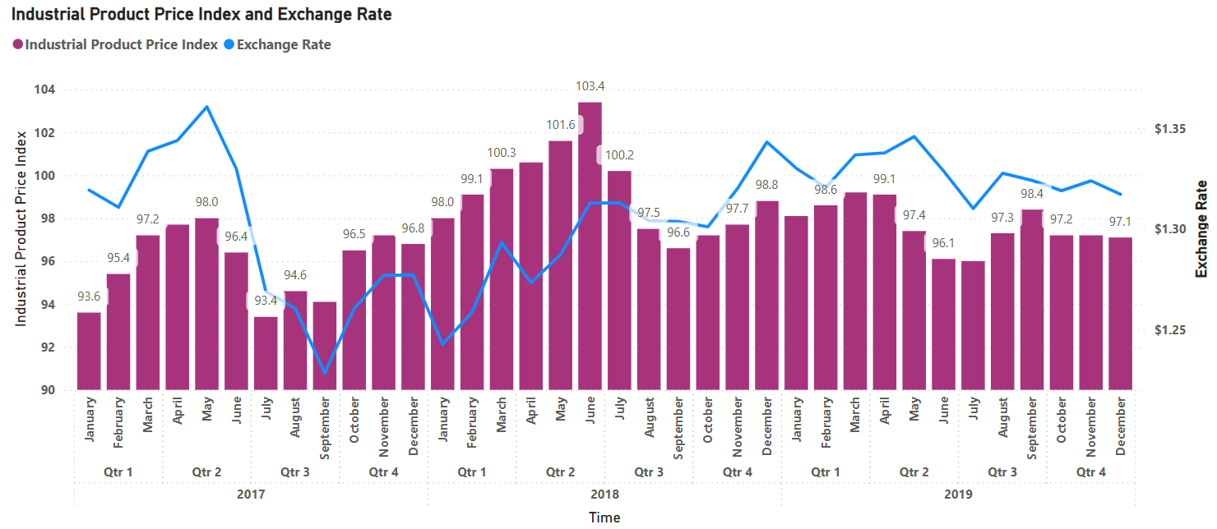
Key Observations from Trade Analysis
Mid-2018 turning point:
Around June 2018, IPPI peaked at 103.4, just before the implementation of U.S. tariffs.
At the same time, the exchange rate began to rise (CAD depreciated vs. USD).
Post-tariff pattern:
From July 2018 onward, despite higher tariffs and a weaker CAD, IPPI began a steady decline.
This trend continued through 2019, stabilizing around 97–98, indicating producer prices fell or remained suppressed.
Expected vs Actual:
Normally, when CAD weakens, imported input costs rise → IPPI should increase.
However, IPPI decreased, indicating external pressures did not pass through to domestic industrial prices.
Interpretation:
The expected outcome—rising IPPI due to higher input costs from both tariffs and exchange rate depreciation—did not occur. Possible explanations include:
Producers absorbed costs to maintain export competitiveness, particularly in sectors facing U.S. tariffs.
Global metal prices fell during 2018–2019, offsetting local cost increases.
Industrial demand weakened, reducing pricing power of manufacturers.
Supply chain adjustments (e.g., sourcing from non-U.S. markets) may have moderated price pressures.
IPPI VS. EXCHANGE RATE
This chart compares Industrial Product Price Index (Primary Metal Manufacturing) – left Y-axis, CAD-USD exchange rate - right Y-axis. During 2017-2019.
Summary Statement：
Although the Canadian dollar weakened and tariffs were imposed, IPPI did not rise as expected. Instead, industrial prices dropped, suggesting that producers bore the cost impact rather than transferring it to price levels. This reinforces the importance of considering macroeconomic variables like exchange rates alongside policy shifts when interpreting price index trends.
Page 14
Page 1
Notes:
4. IPPI vs Exchange Rate
Finally, we analyze the link between industrial producer prices (IPPI) and the exchange rate.
Normally, when the Canadian dollar weakens, import costs rise — so IPPI should increase.
This indicates that producers absorbed the higher costs instead of passing them on to consumers,
likely due to weak demand and competitive pressure in export markets.
Summary and Transition to Conclusion
To summarize our multivariate analysis:
* Tariffs had a clear negative correlation with trade and industrial GDP;
* Manufacturing employment fell with a lagged effect;
* Prices stayed flat because producers absorbed costs;
* And even after tariffs were lifted, the economy did not fully bounce back — showing long-term structural impacts.

Slide 17
IMPACT OF U.S. TARIFFS ON THE CANADIAN ECONOMY – SUMMARY OF FINDINGS
Policy Overview:
In June 2018, the United States imposed tariffs of up to 25% on Canadian steel and 10% on aluminum products, lasting until May 2019.
As the U.S. accounts for over 80% of Canada’s metal exports, the policy had immediate and far-reaching effects across trade, industry, and employment.
Summary of Data-Driven Findings:
Area of Impact | Key Findings
Trade Volume | Sharp decline in metal import/export with the U.S. during tariff period
GDP – Metal Sector | Noticeable drop post-tariff, with high volatility and no full recovery
Price Indices (IPPI/CPI) | Unexpected decline after tariffs, indicating demand slowdown and cost absorption
Employment | Manufacturing job losses and rising unemployment rate in the sector
U.S. Dependence | Over 80% of trade in top 5 partners is with the U.S., magnifying impact
Conclusion & Insights:
The U.S. tariffs caused measurable economic disruption in Canada, particularly in trade-exposed and labor-intensive sectors.
Despite resilience at the macro level, structural vulnerabilities such as over-reliance on a single market were clearly exposed.
The data shows that external trade shocks can have lasting sector-specific consequences, even after policy reversal.
Page 15
Notes:
Policy Context & Recap（政策回顾与整体结论）
Let’s wrap up our analysis with the big picture.
In June 2018, the United States imposed tariffs of up to 25 percent on Canadian steel and 10 percent on aluminum products, lasting until May 2019.
Because over 80 percent of Canada’s metal exports go to the U.S., this policy immediately rippled through Canada’s trade, industry, and employment.
Using Power BI and official economic data, we were able to quantify those impacts and see how they unfolded across different sectors.
2. Summary of Data-Driven Findings （数据驱动的主要发现）
Here’s a summary of our key findings from the data:
• Trade Volume – Metal imports and exports with the U.S. plunged during the tariff period. • GDP in the Metal Sector – Dropped significantly after tariffs and never fully recovered. • Price Indices (IPPI/CPI) – Instead of rising, they fell, suggesting cost absorption and weaker demand. • Employment – Manufacturing jobs declined, with a lagged increase in unemployment. • U.S. Dependence – Over 80 percent of trade with top partners was U.S.-based, amplifying the impact.
In short, the tariffs caused clear sector-specific damage — especially to industrial and labor-intensive areas — even though Canada’s macro economy remained largely resilient.

Slide 18
STRATEGIC RECOMMENDATIONS BASED ON DATA INSIGHTS
Targeted Suggestions by Impact Area:
Area of Impact | Key Findings
Heavy U.S. Trade Dependence | Diversify export markets through FTAs (e.g., EU, Asia-Pacific); support exporters with trade financing
GDP Decline in Metal Sector | Provide short-term subsidies and long-term R&D incentives for industrial innovation
Price Index Drop (IPPI/CPI) | Improve supply chain infrastructure; introduce price monitoring for essential goods
Employment Contraction | Launch retraining programs; enhance EI support for manufacturing workers; promote industrial youth programs
Final Summary:
A data-driven response is essential to address the economic vulnerabilities revealed by the tariff episode.
Canada should adopt a multi-pronged strategy:
Reduce reliance on single markets
Reinforce industrial resilience
Support labor force adaptation
Monitor early warning indicators
Only through proactive, diversified, and inclusive policies can Canada ensure long-term economic stability amid global trade volatility.
Page 16
Notes:
Strategic Recommendations
Based on these insights, we propose a set of targeted recommendations:
• Reduce U.S. Dependence: Diversify export markets through free trade agreements with the EU and Asia-Pacific regions, and support exporters with trade financing.
• Stabilize the Metal Sector: Provide short-term subsidies to offset losses and long-term R&D incentives to foster industrial innovation.
• Address Price and Supply Risks: Invest in supply chain infrastructure and introduce price monitoring for key industrial inputs.
• Support Employment Recovery: Launch retraining and up-skilling programs for manufacturing workers and youth employment initiatives in industrial regions.
In other words, Canada needs a data-driven, multi-pronged strategy — reduce reliance, reinforce resilience, and rebuild competitiveness.
2. Final Closing Statement
To conclude, this project shows how data analytics can turn a policy event into measurable insights.
Trade policies come and go, but their impacts linger — and only through continuous, evidence-based monitoring can countries stay resilient in the global economy.
Thank you for listening — and I hope this analysis inspires you to see how Power BI and data can tell a story far beyond the numbers.

